Slide 1
Current Project Update EasyEMR
Jerell Robinson
Evan Michaux
Nicholas Rushak
Priyesh Pandya

Slide 2
Previous Iteration Oct. 1-Oct 13
1. Fix the Admin page to restrict to only registered admins. (80 % done)
2. Create previous patient search on Triage Page. (90 % done)
3. Create default admin for initial user creation. (Done)
4. Modify Triage UI for landscape view. (Done)
5. Fix the search to only search for encountered.

Slide 3
Previous Iteration Oct. 1-Oct 13
6. Add new required fields. (Done)
7. Revamp navigation bar design. (Done)
8. Additional required fields added to necessary pages. (Done)

Slide 4
Next Iteration Oct. 13th
1. Fix issue with triage page not automatically filling in the user fields on search.
2. Modify the Admin page to restrict to only registered admins.
3. Fix issue with Pharmacy page links disabling scrolling.
4. Utilize unit tests and perform heavy testing.
5. Encounter ID remains at zero when adding patients.
6. Resizing of fields based on screen resolution.

Slide 5
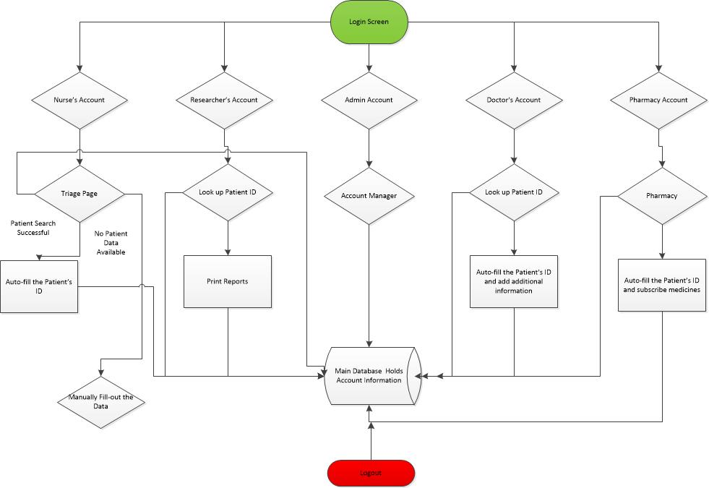

Slide 6
Testing Plan
Testing plan will begin on November 3rd, 2013 until November 14th, 2013.
No new features will be added from testing duration.
Setup the App on the client’s computers on November 3rd, 2013.
Team will test the software from all aspects including unit testing and ad-hoc network.

Slide 7
Thanks for Listening!!

